Slide 1
MIS 3720 Final Presentation
Allison Escott, Bishoy Soliman, Franco Bazzini, Katelyn Tropeano, Katie Houskeeper, Vishnu Priya Dendukuri
Notes:
alli

Slide 2
Business Problem
The business problem we worked to solve is the issue of a hospital admitting more patients than the number of beds available. Relevant aspects of the hospital we are looking into in order to develop our database are nurses, doctors, patients, rooms and departments. We developed a database that stores information regarding which rooms are currently occupied and which are still available. This will allow for an easily accessible database to allow for the correct number of patients to be admitted based on beds available.
Notes:
Alli

Slide 3
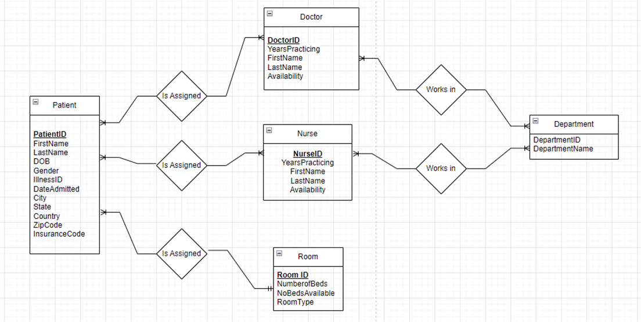
Entity-relationship diagram
Notes:
Franco

Slide 4
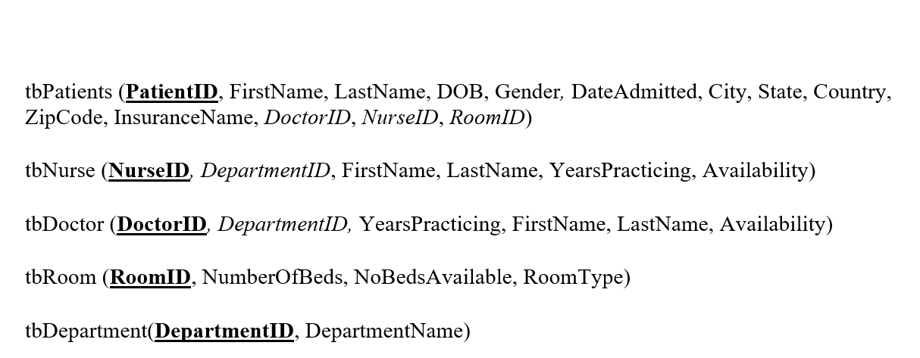
Logical Model
Notes:
Franco

Slide 5
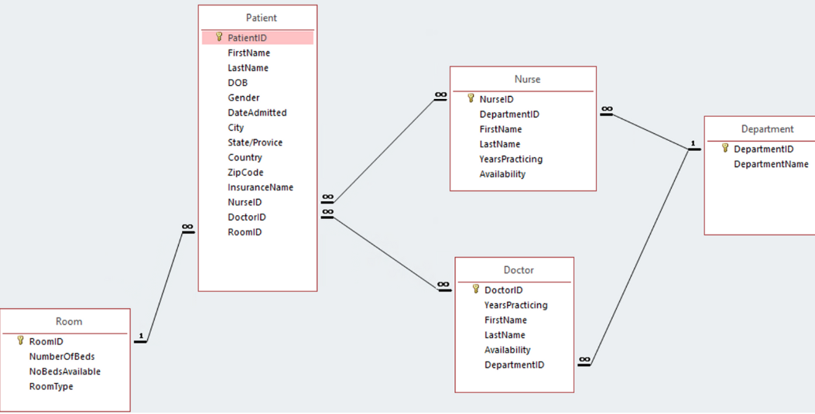
Access relationship diagram
Notes:
Franco

Slide 6
Types of Tables
Patient
nURSE
doctor
room
Department
Notes:
Katelyn

Slide 7
Column | Data Type | Description | Purpose
DepartmentID | Short Text | Primary key of the Department Table | DepartmentID is in the table because it will be the way a department is identified. Each department will have its own unique ID
DepartmentName | Short Text | Name of the department | DepartmentName is in the table because it will be used to identify the name of each department.
Notes:
Katelyn

Slide 8
RELATIONSHIPS
Room (1) - Patient (∞)
Patient (∞) - Nurse (∞)
Patient (∞)- Doctor (∞)
Doctor (∞) - Department (1)
Nurse (∞) - Department (1)
Notes:
Katelyn

Slide 9
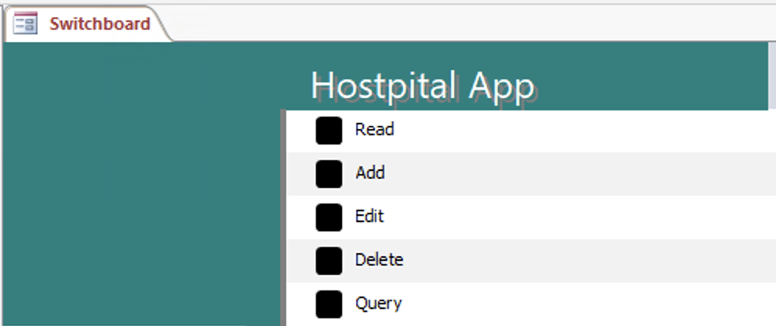
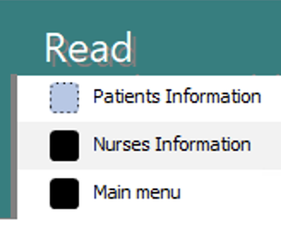
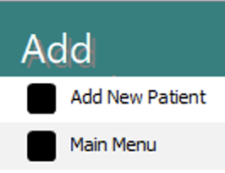
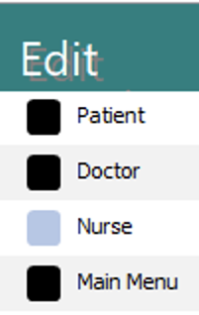
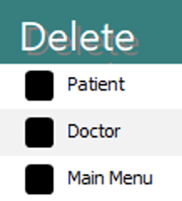
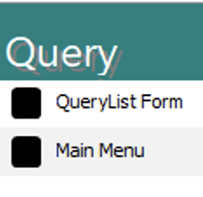
Switchboard
MAIN
SUB
Notes:
Alli
In addition to creating the database, we also designed an Access switchboard. The purpose of the switchboard is to provide a user-friendly interface for individuals who may not be familiar with using Access, allowing them to easily navigate and utilize the database.
Our main switchboard comprises five sub-switchboards, each equipped with a back button that allows users to easily navigate back to the main switchboard. For detailed instructions on how to use our switchboard, please refer to our User Documentation report.

Slide 10
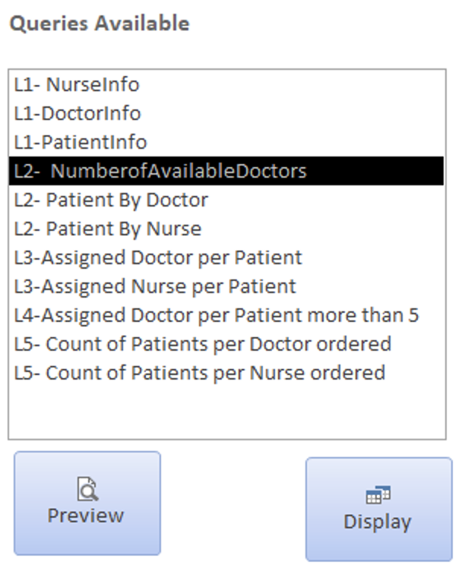
Queries
Notes:
Vishnu
These are some of the queries we wrote and we will go into detail in the next slide.

Slide 11
Ten Queries
L1-NurseInfo
SQL code: SELECT *
FROM Nurse;
L1-DoctorInfo
SQL Code: SELECT Doctor.DoctorID, Doctor.FirstName, Doctor.LastName
FROM Doctor;
L1-PatientInfo
SQL Code: SELECT Patient.PatientID, Patient.FirstName, Patient.LastName, Patient.Gender, Patient.DOB
FROM Patient;
L2-Patient By Doctor
SQL Code: SELECT Patient.PatientID, Patient.FirstName, Patient.LastName
FROM Patient
WHERE Patient.DoctorID = "KLM-852";
L2-Patient By Nurse
SQL Code: SELECT Patient.PatientID, Patient.FirstName, Patient.LastName
FROM Patient
WHERE Patient.NurseID = "FGH-369";
L2- Number of Available Doctors
SQL Code: SELECT Doctor.DoctorID AS DoctorsAvailable
FROM Doctor
WHERE (((Doctor.Availability)=True));
Notes:
Vishnu
NurseInfo query displays all the information from the nurse table
Doctor info query displays the doctor id and name from the Doctor table
Patient info query similarly displays few patient attributes such as name, ID, gender and dob
Patient by doctor query displays the the patient id and name of patients who have the same doctor
Similarly , patient by nurse displays info of the patients under the care of same nurse
Number of available doctors query displays all the doctor’s IDs that are currently available to take in more patients

Slide 12
Ten Queries
L-3 Assigned Nurse Per Patient
SQL Code: SELECT Patient.PatientID, Patient.FirstName AS PatientFirstName, Patient.LastName AS PatientLastName, Nurse.FirstName AS NurseFirstName, Nurse.LastName AS NurseLastName
FROM Patient INNER JOIN Nurse ON Patient.NurseID = Nurse.NurseID;
L-3 Assigned Doctor Per Patient
SELECT Patient.PatientID, Patient.FirstName AS PatientFirstName, Patient.LastName AS PatientLastName, Doctor.FirstName AS DoctorFirstName, Doctor.LastName AS DoctorLastName
FROM Patient INNER JOIN Doctor ON Patient.DoctorID = Doctor.DoctorID;
L4- Assigned Doctor per Patient More than 5 Years Practicing
SQL Code:SELECT Patient.PatientID, Patient.FirstName AS PatientFirstName, Patient.LastName AS PatientLastName, Doctor.FirstName AS DoctorFirstName, Doctor.LastName AS DoctorLastName
FROM Patient INNER JOIN Doctor ON Patient.DoctorID = Doctor.DoctorID
WHERE Doctor.YearsPracticing >5;
L5-Count of Patients per Nurse Ordered
SQL Code: SELECT Patient.NurseID, Nurse.FirstName, Nurse.LastName, COUNT(Patient.NurseID) AS NumberOfPatients
FROM Patient INNER JOIN Nurse ON Patient.NurseID = Nurse.NurseID
WHERE Nurse.YearsPracticing >1
GROUP BY Patient.NurseID, Nurse.FirstName, Nurse.LastName
ORDER BY COUNT(Patient.NurseID);
L5- Count of Patients per Doctor Ordered
SQL Code: SELECT Patient.DoctorID, Doctor.FirstName, Doctor.LastName, COUNT(Patient.DoctorID) AS NumberOfPatients
FROM Patient INNER JOIN Doctor ON Patient.DoctorID = Doctor.DoctorID
GROUP BY Patient.DoctorID, Doctor.FirstName, Doctor.LastName
ORDER BY COUNT(Patient.DoctorID);
Notes:
Vishnu
Assigned Nurse per patient query produces a table where we can see the names of the patients and which nurses they are assigned too. It allows us to see that certain doctors have more than one patient as well.
Similarly, the Assigned doctors per patients displays the patient info and doctor info that they are assigned to.
Assigned doc per patient more than 5 yreas practicing query help us identify patients with the doctors who have been practicing for more than 5 years.
Count of patients per doctor ordered query displays the doctor info with the total number of patients they are handling in ascending order of the count.
Count of patients per nurse does the same but with the years of experience being more than a year

Slide 13

IMPLEMENTATION ISSUES
Initial understanding of hospital operations lead to incorrect database relationships
Addition of unnecessary FKs into ERD and Conceptual Model
Creating user-friendly and operable switchboard
Database was unable to be operated concurrently
Notes:
katie

Slide 14


Recommendations TO ENSURE DATA QUALITY
DATA RECOVERY & BACKUP PROCEDURE
Company Initiatives
Data governance
Data stewardship
Employee training and education
How to operate system
Ensure data quality
Importance
Database Features
Unique ID values & required fields
Switchboard features
Add/Edit: Dropdown options
Delete: Uneditable
Undo and Save buttons
Daily database backups
Minimize data loss
Human Error
System malfunction
Data security is high priority
Firewalls
Encryption
Access controls
Notes:
Katie

Slide 15
LIVE DEMO
Notes:
Katelyn bishoy

Slide 16
Thank you!
Any Questions?

